Slide 1
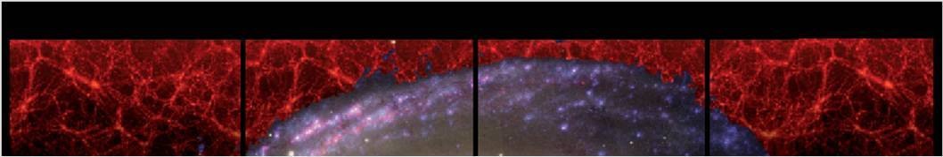
DARK MATTER IN GALAXIES
NAME
INSTITUTE
Dec. 1-8, 2010
Notes:
1

Slide 2
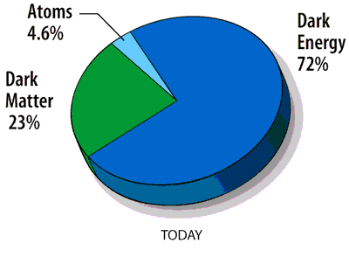
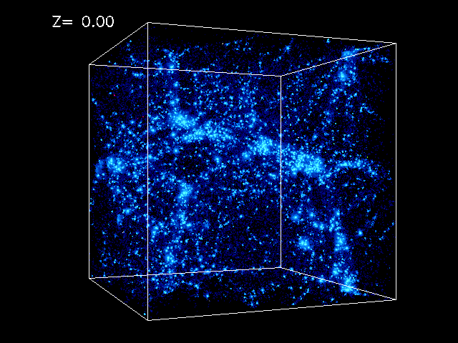
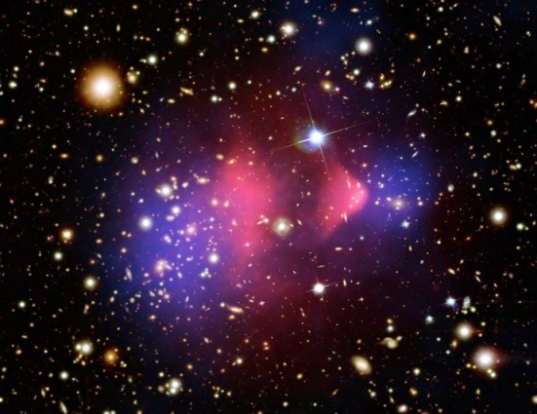
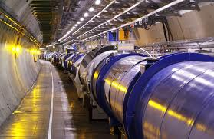
Outline of the Review
Dark Matter is main protagonist in the Universe
The concept of Dark Matter in virialized objects
Dark Matter in Spirals, Ellipticals, dSphs
Dark and Luminous Matter in galaxies. Global properties.
Phenomenology of the mass distribution in Galaxies.
Implications for Direct and Indirect Searches
This review focus: Dark Matter in Galaxies
Notes:
2

Slide 3
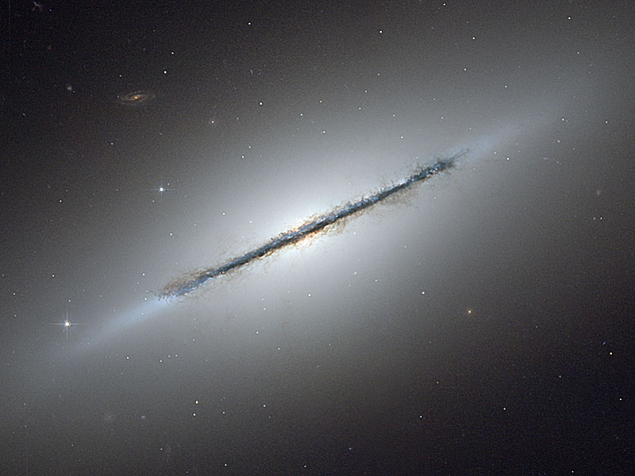
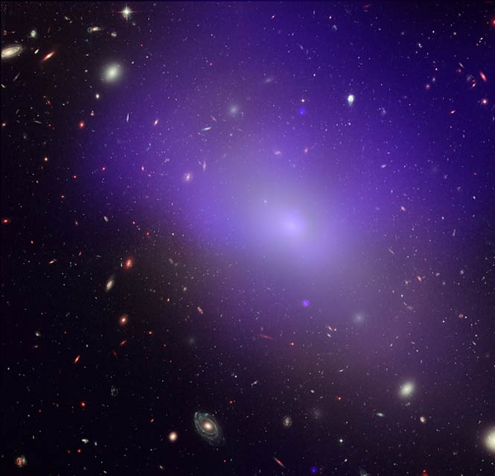
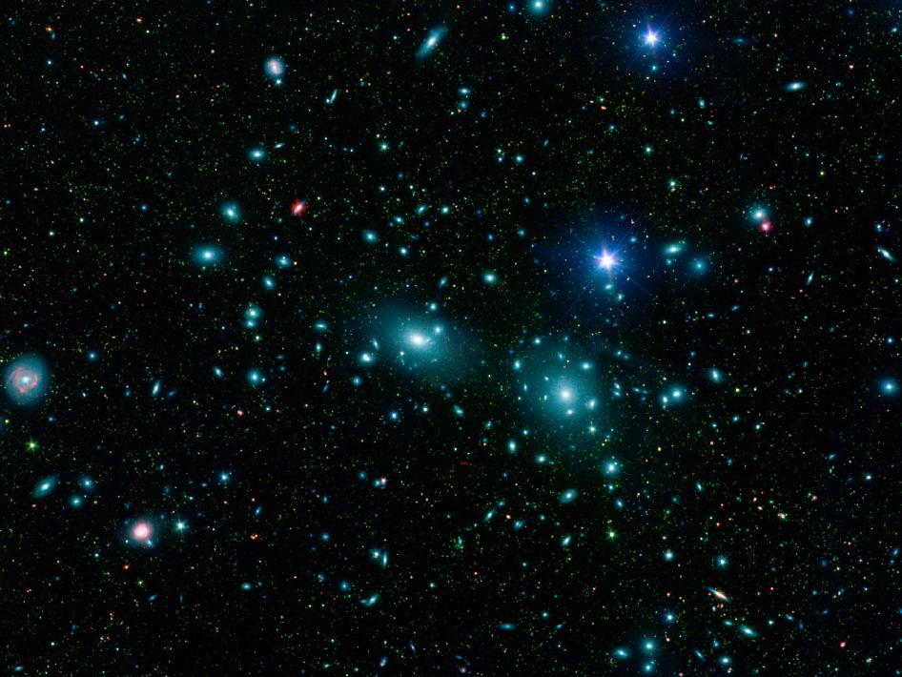
spiral
elliptical
3 major types of galaxies
dwarfs

Slide 4
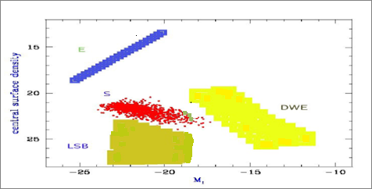
The Realm of Galaxies
The range of galaxies in magnitudes, types and central surface densities : 15 mag, 4 types, 16 mag arsec⁻²
Central surface brightness vs galaxy magnitude
Dwarfs
Spirals : stellar disk +bulge +HI disk
Ellipticals & dwarfs E: stellar spheroid
The distribution of luminous matter :
Notes:
4

Slide 5

What is Dark Matter ?
In a galaxy, the radial profile of the gravitating matter M(r) does not match that of the luminous component M_{L}(r).
A MASSIVE DARK COMPONENT is then introduced to account for the disagreement:
Its profile M_{H}(r) must obey:
M(r), M_{L}(r), dlog M_{L}(r)/dlog r observed
The DM phenomenon can be investigated only if we accurately meausure the distribution of:
Luminous matter M_{L}(r).
Gravitating matter M(r)
Notes:
5
The best way to define the phenomenon of Dark Matter is the following: let us set M(r ) the mass distribution of the gravitating matter and ML(r) that of the sum of all baryonic "luminous" components.
We can obtain them both from observations; we first realize that, from a certain radius r_T outwards, function of galaxy luminosity and Hubble Type, these distributions strongly do not match, i.e. dlog M/dlog r> d log ML/dlog r. We are then forced to introduce a dark matter component whose mass profile MH(r) accounts for the disagreement:
dlog M(r)/dlog r = ML(r)/M(r) * dlog ML/dlog r + MH(r)/M(r) * dlog MH /dlog r
This way to introduce the dark matter immediately shows that the phenomenon of the mass discrepancy in galaxies emerges from the radial derivative of the mass distribution, more precisely from that of the circular velocity and/or the dispersions velocity that estimates it M ~ r V2(r) ~ σ2(r).
The DM phenomenon can emerge only if we know very well the distribution of luminous matter and we can accurately measure the distribution of the all gravitating matter

Slide 6
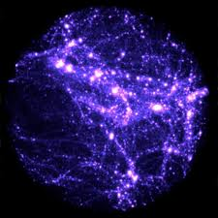
THEORY AND SIMULATIONS

Slide 7
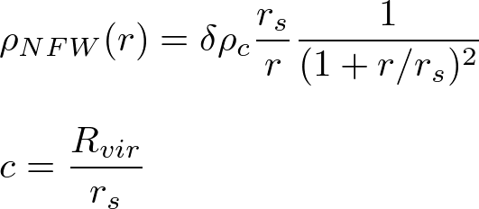
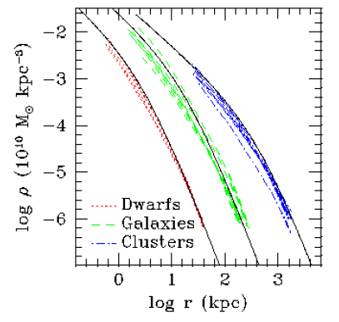

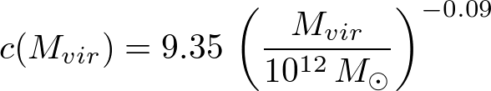
ΛCDM Dark Matter Density Profiles from N-body simulations
The density of virialized DM halos of any mass is empirically described at all times by an Universal profile (Navarro+96, 97, NFW).
More massive halos and those formed
earlier have larger overdensities
Today mean halo density inside
R_{vir} = 100 ϱ_{c}
Klypin, 2010

Slide 8
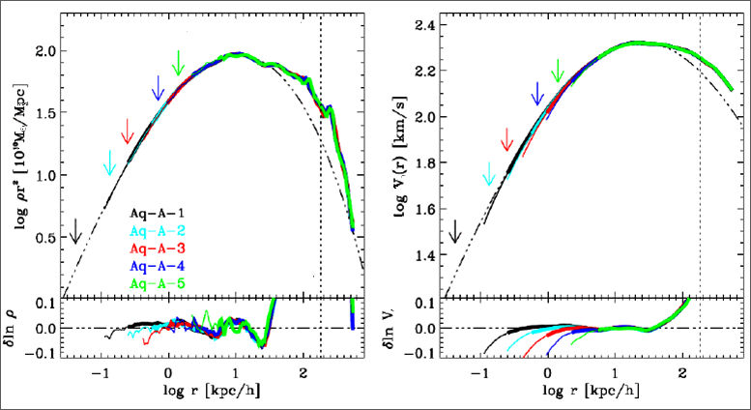
Aquarius N-Body simulations, highest mass resolution to date.
Density distribution: the Einasto Law indistinguishable by NFW
density circular velocity
Navarro et al +10
V=const

Slide 9

How halos form and evolve

Slide 10
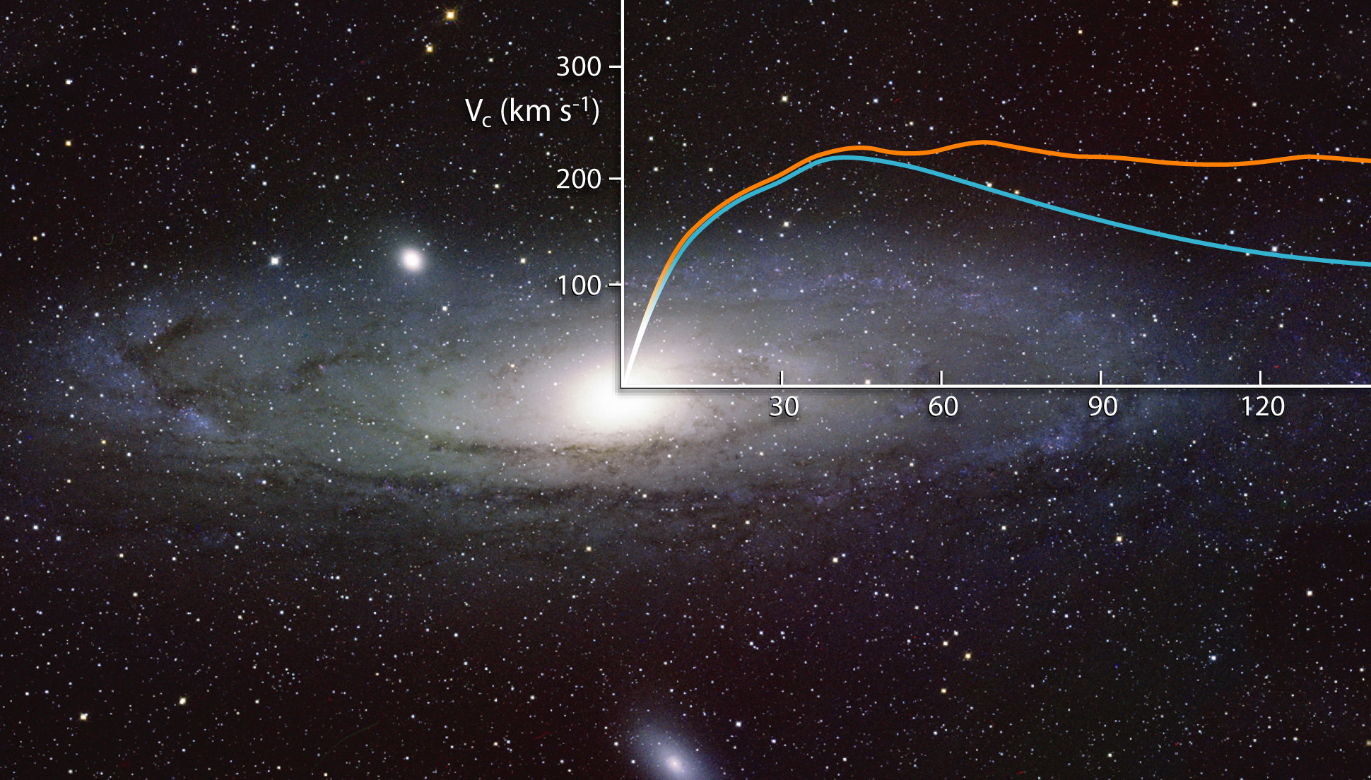
SPIRALS

Slide 11
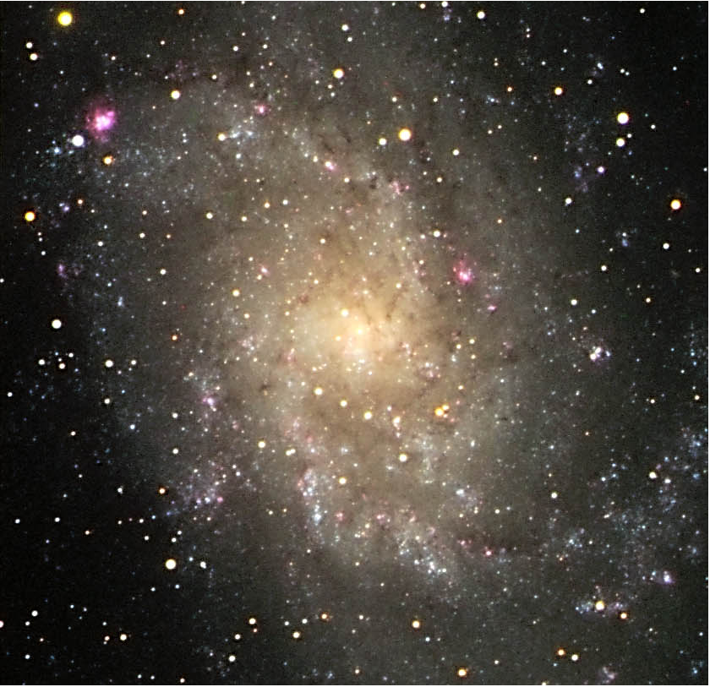
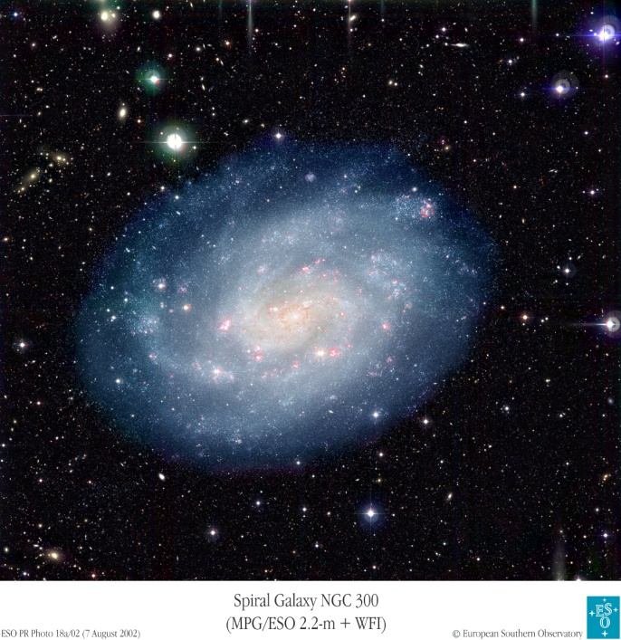

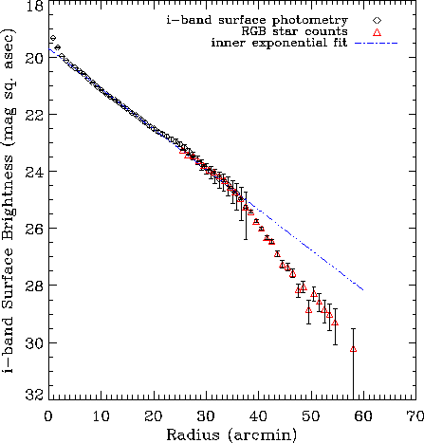
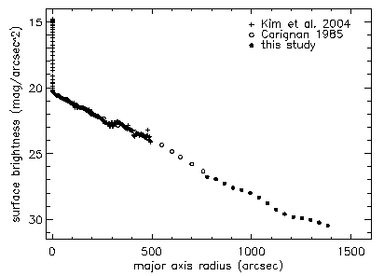
Stellar Disks
M33 disk very smooth,
truncated at 4 scale-lengths
NGC 300 exponential disk
for at least 10 scale-lengths
R_{D} lenght scale of the disk
Freeman, 1970
Bland-Hawthorn et al 2005
Ferguson et al 2003
Notes:
11

Slide 12
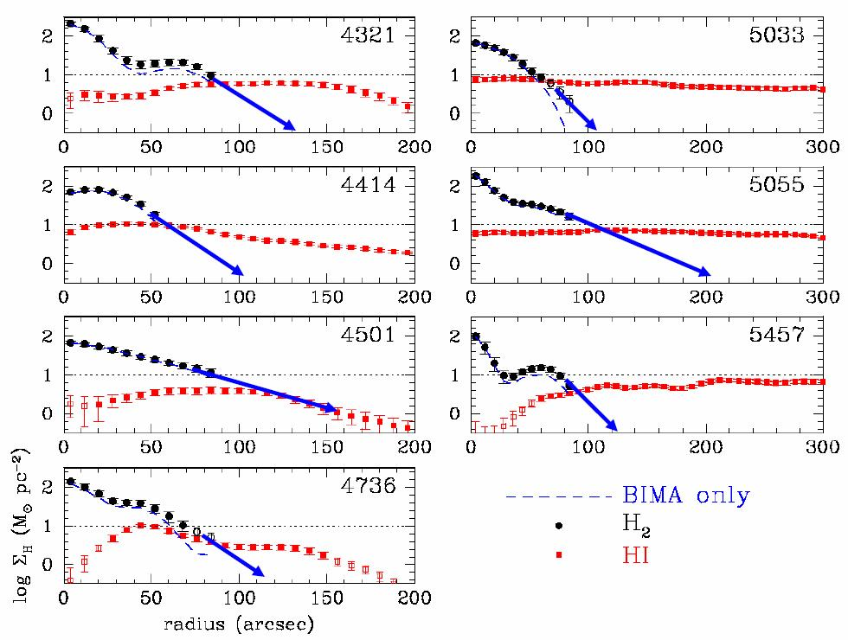
Gas surface densities
H₂
HI
HI
Flattish radial distribution
Deficiency in the centre
Extended to (8 – 40) R_{D}
H₂
Follows the stellar disk
Negligible
Wong & Blitz (2002)
Notes:
12

Slide 13
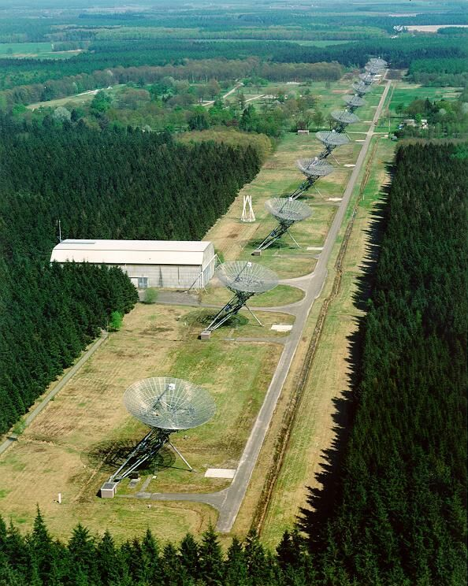
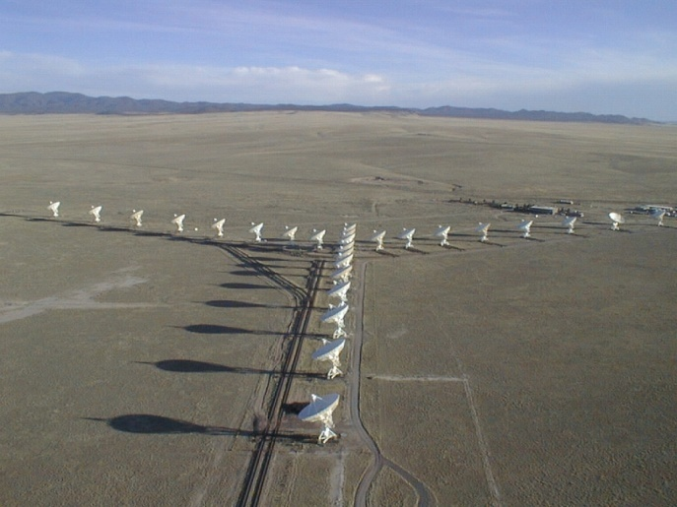
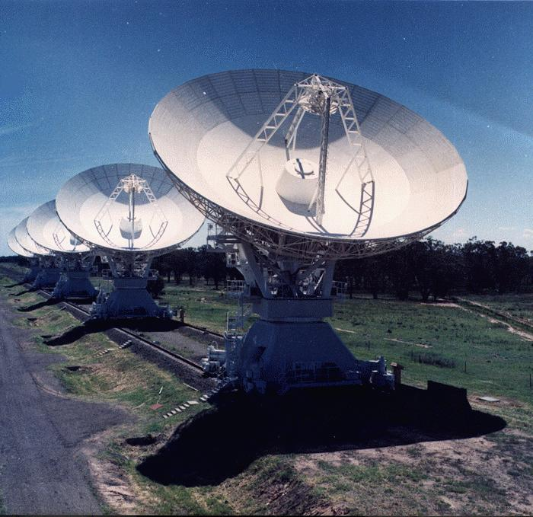
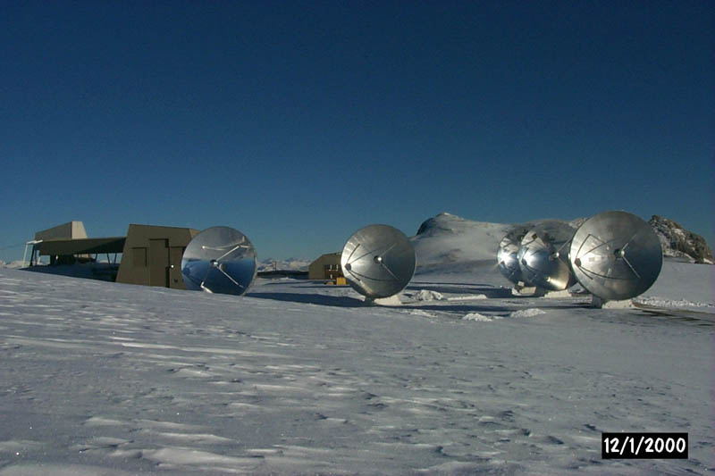
Circular velocities from spectroscopy
- Optical emission lines (Hα, Νa)
- Neutral hydrogen (HI)-carbon monoxide (CO)
Tracer angular spectral resolution resolution
HI 7" … 30" 2 … 10 km s⁻¹
CO 1.5" … 8" 2 … 10 km s⁻¹
Hα, … 0.5" … 1.5" 10 … 30 km s⁻¹
WSRT
VLA
IRAM
ATCA
Notes:
13

Slide 14
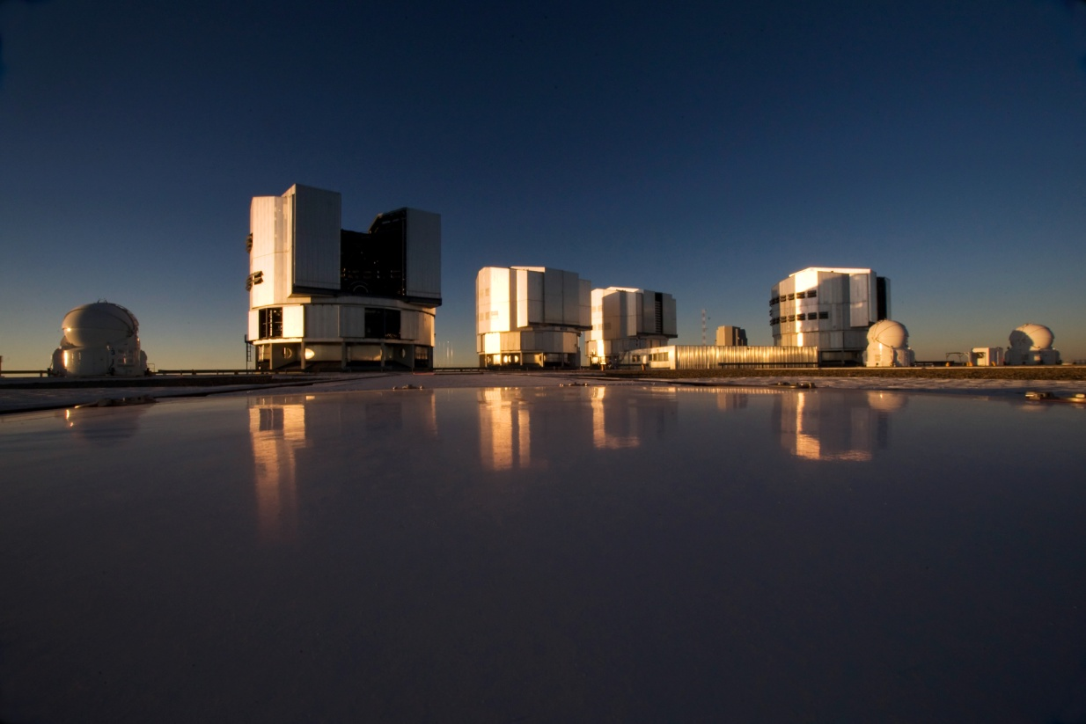
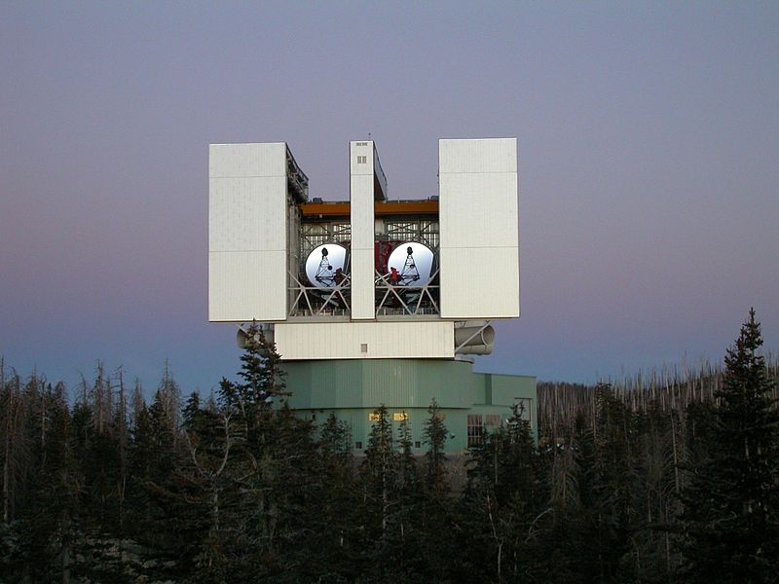
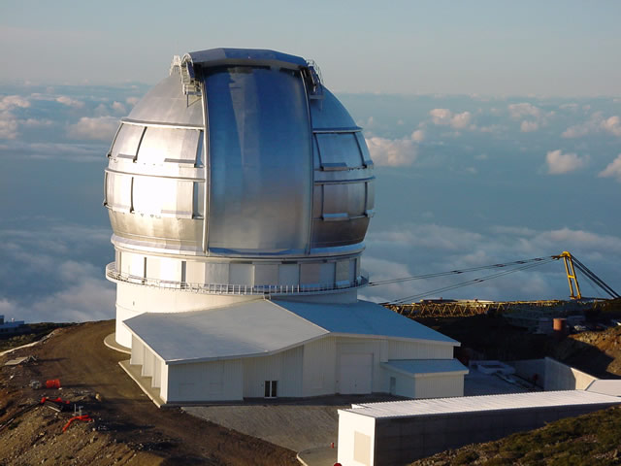
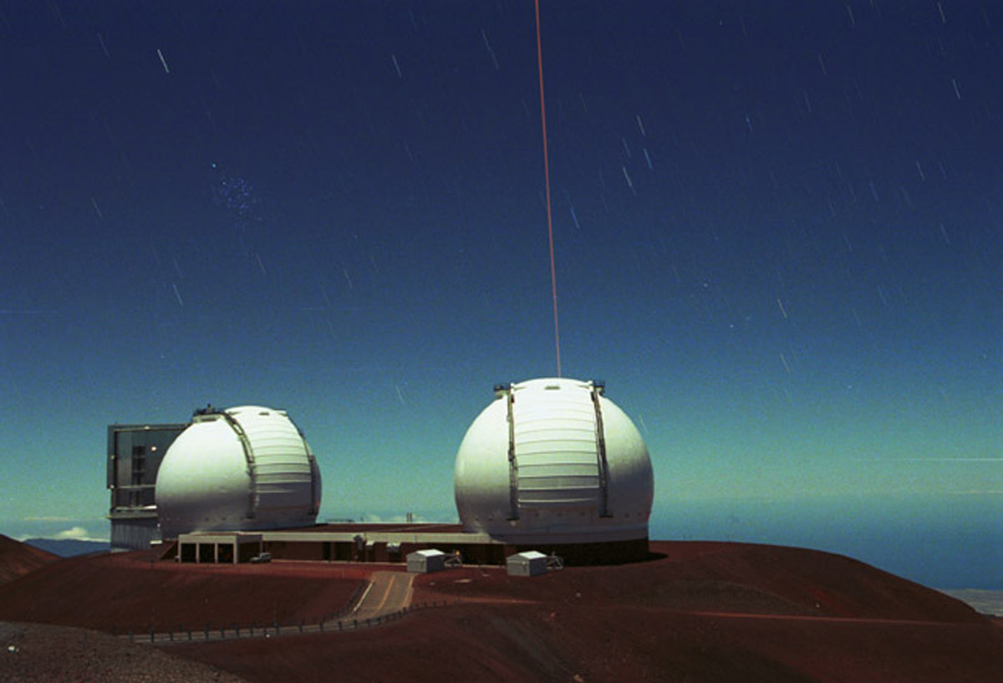
VLT
LBT
KECK
GTC

Slide 15
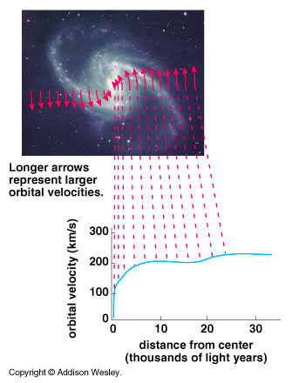
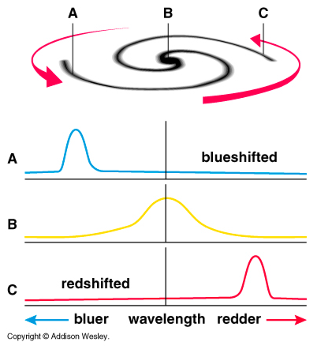
ROTATION CURVES
artist impression
artist impression

Slide 16
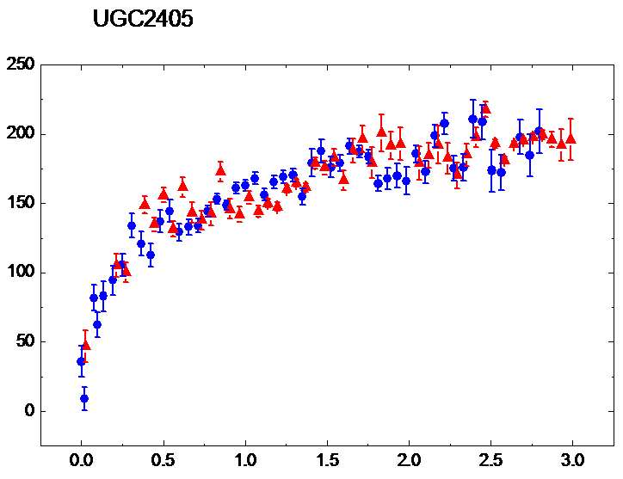
Symmetric circular rotation of a disk characterized by
Sky coordinates of the galaxy centre
Systemic velocity V_{sys}
Circular velocity V(R)
Inclination angle
HIGH QUALITY ROTATION CURVE
r
receeding arm
V(R/R_{D})
trailing arm
R/R_{D}
Notes:
16

Slide 17
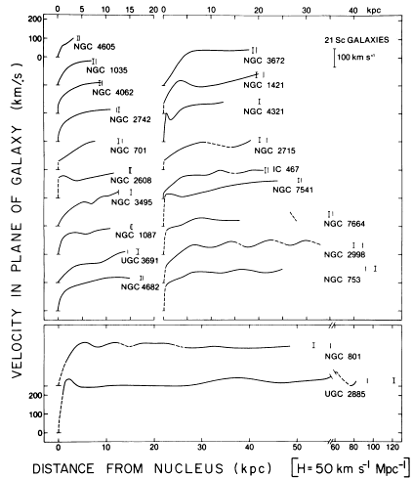
Early discovery from optical and HI RCs
RC DO NOT follows the disk velocity profile
disk RC profiles of different
lenght scale and amplitude
Rubin et al 1980
Mass discrepancy AT OUTER RADII
Notes:
17

Slide 18
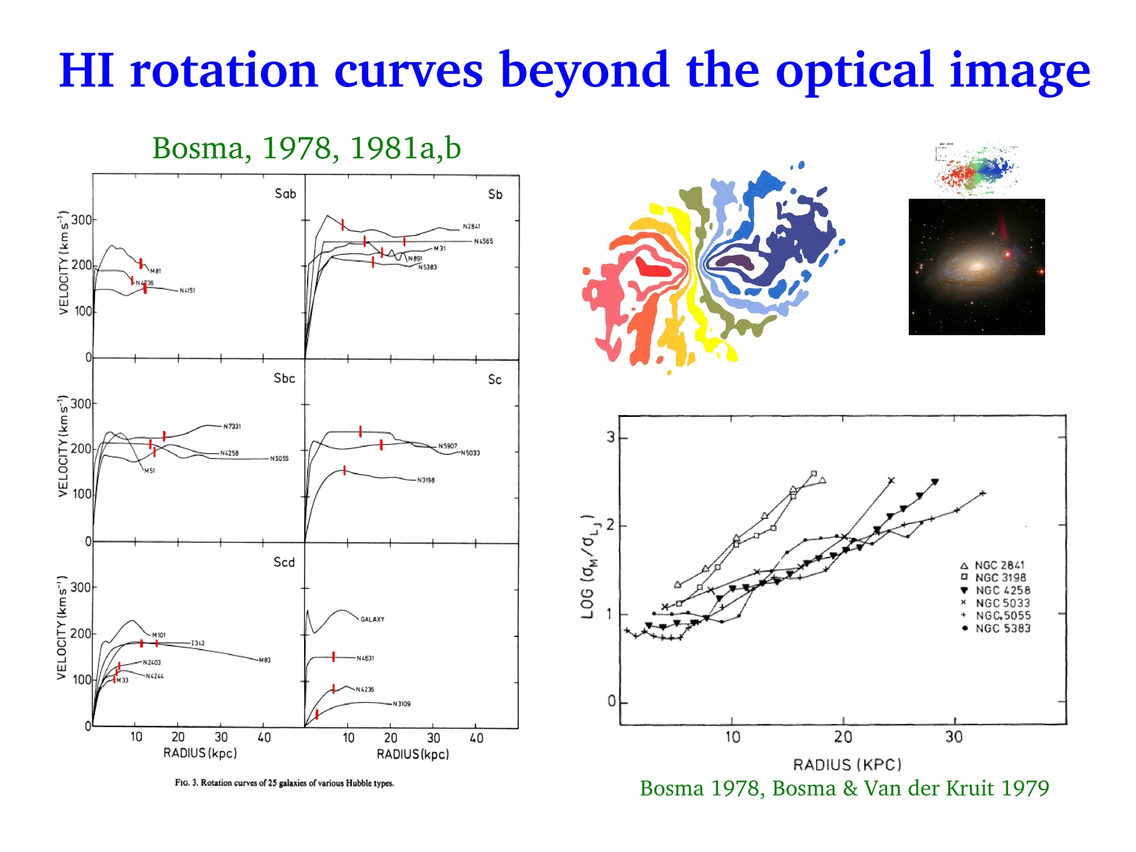
R_{opt}
light traces the mass

Slide 19
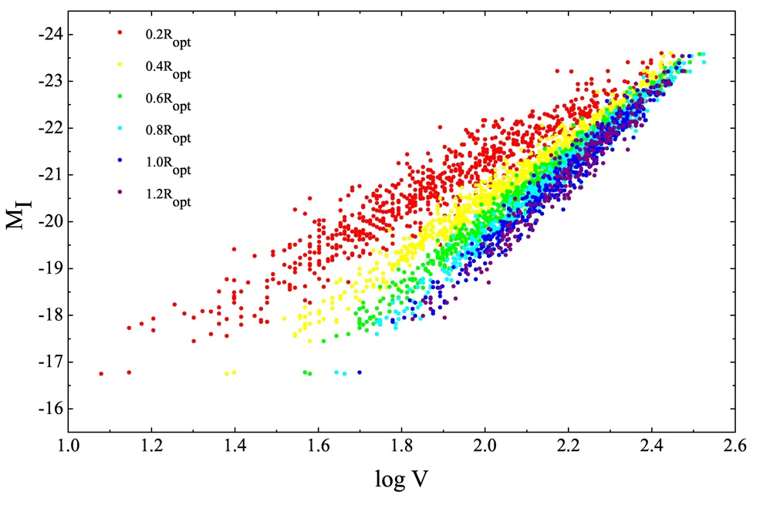

Evidence for a Mass Discrepancy in Galaxies
The distribution of gravitating matter, unlike the luminous one, is luminosity dependent.
Tully-Fisher relation exists at local level (radii R_{i})
no DM
Yegorova et al 2007
Notes:
19

Slide 20
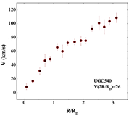
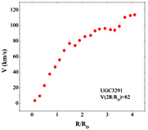
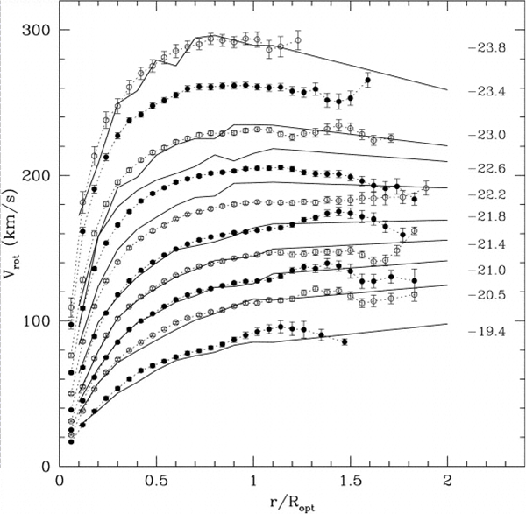
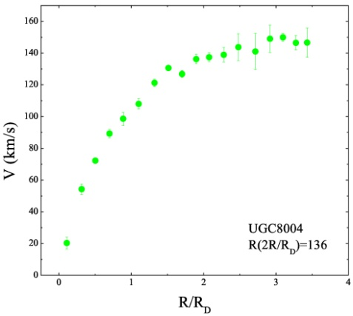
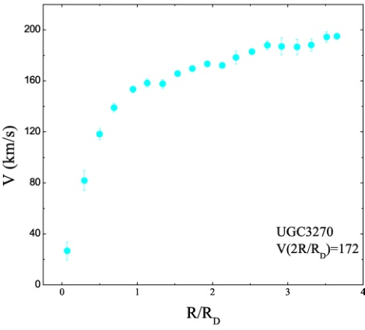
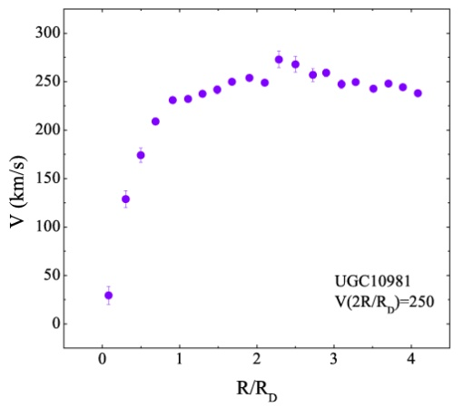
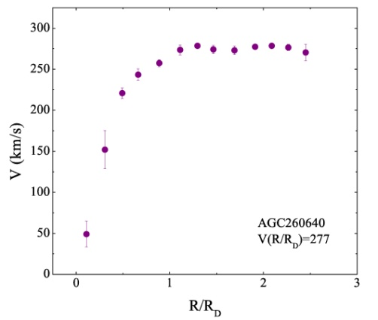
Rotation Curves
Coadded from 3200 individual RCs
TYPICAL INDIVIDUAL RCs OF INCREASING
LUMINOSITY
Low lum
Salucci+07
mag
high lum
6 R_{D}
6 R_{D}
Notes:
20

Slide 21
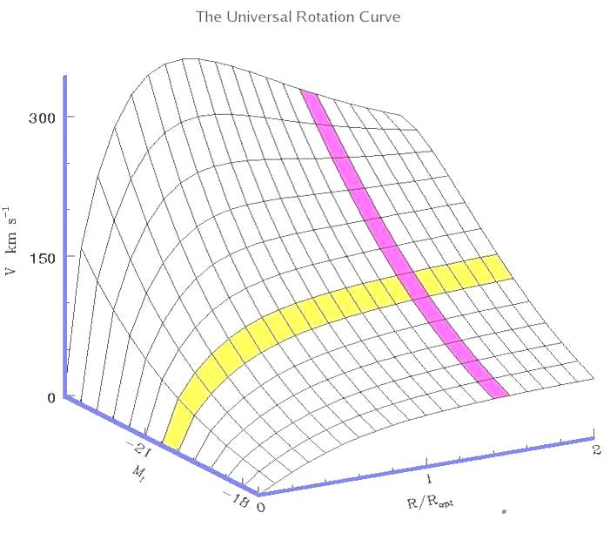
The Cosmic Variance of V measured in galaxies of same luminosity L at the same radius x=R/R_{D} is negligible compared to the variations that V shows as x and L varies.
same radius
same luminosity
Notes:
21

Slide 22
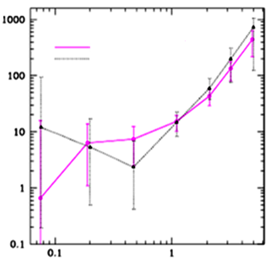
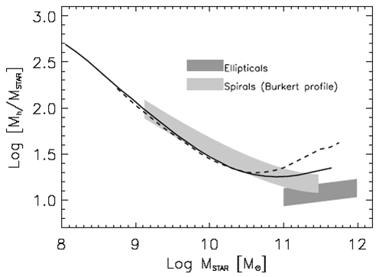

Universal Rotation Curve out to the Virial Radius
Method: inner kinematics + independent determinations of halo virial masses
Moster, et al 2010
SPIRALS
ELLIPTICALS
Shankaret al, 2006
Mandelbaum et al 2006
L/L*
Virial masses M_{h} of halos around galaxies with stellar mass M_{STAR} (or luminosity L ) are obtained
- directly by weak-lensing analysis (left)
- indirectly by correlating dN/dL with theoretical DM halo dN/dM (right)
Notes:
22

Slide 23
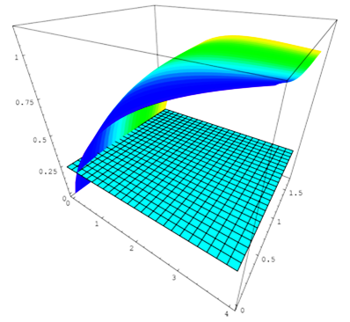
The Concept of the Universal Rotation Curve (URC)
Every RC can be represented by: V(x,L) x=R/R_{D}
V/V_{opt}
L
R/R_{D}
The URC out to 6 R_{D} is derived directly from observations
Extrapolation of URC out to virial radius by using V(R_{vir} )
-> Movie 2
Notes:
23

Slide 24



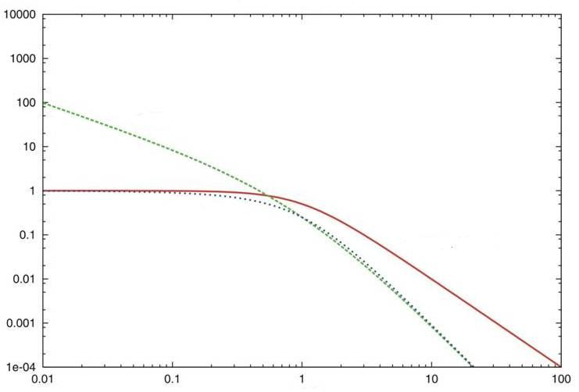



Rotation curve analysis
From data to mass models
observations
=
model
from I-band photometry
from HI observations
different choices for the DM halo density
Dark halos with central constant density (Burkert, Isothermal)
Dark halos with central cusps (NFW, Einasto)
NFW
ISO
The mass model has 3 free parameters:
disk mass
halo central density
Halo core radius (length-scale)
Obtained by best fitting method
Burkert
Notes:
24

Slide 25
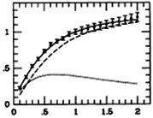
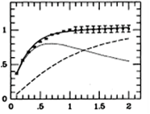
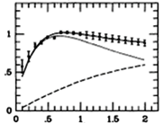


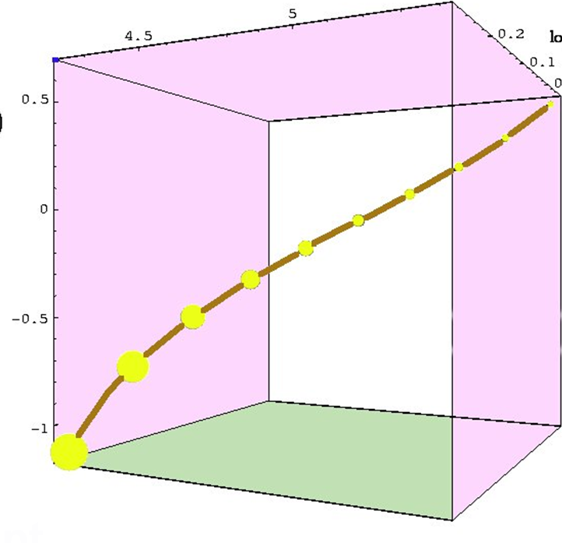
MASS MODELLING RESULTS
M_{I} = -18
M_{I} = - 21
M_{I} = - 23
lowest luminosities
highest luminosities
halo
disk
halo
disk
disk
halo
halo central density
All structural DM and LM
parameters are related
with luminosity.g
Smaller galaxies are denser and have a higher proportion of dark matter.
core radius
fraction of DM
luminosity

Slide 26



Dark Halo Scaling Laws in Spirals
Careful investigation of relationships between halo structural parameters and luminosity.
via mass modelling of individual galaxies
- Assumption: Maximun Disk, 30 objects
- the central slope of the halo rotation curve gives the halo core density
- extended RCs provide an estimate of halo core radius r₀
Kormendy & Freeman (2004)
ρ_{o}
URC
ρ_{o} ~ L_{I}^{- 0.7}
r_{o} ~ L_{I} ^{0.7}
ρ_{o} ~ L_{B}^{- 0.6}
r_{o} ~ L_{B} ^{0.6}
r_{o}
Notes:
26

Slide 27


The halo central surface density : constant in Spirals
3.0
2.5
2.0
1.5
1.0
URC
Kormendy & Freeman (2004)
Kormendy & Freeman (2004)

Slide 28





The distribution of DM around spirals
Using individual galaxies Gentile+ 2004, de Blok+ 2008 Kuzio de Naray+ 2008, Oh+ 2008, Spano+ 2008, Trachternach+ 2008, Donato+,2009
A detailed investigation: high quality data and model independent analysis
Notes:
28

Slide 29


EXAMPLES
DDO 47
Gentile et al 2005
Oh et al , 2008
NFW
Burkert
halo B
V
halo
gas B
disk B
gas
disk
General results from several samples e.g. THINGS
- Non-circular motions are small.
- DM halo spherical
ISO/Burkert halos much more preferred over NFW
Tri-axiality and non-circular motions cannot explain the CDM/NFW cusp/core discrepancy
R
Notes:
29

Slide 30
SPIRALS: WHAT WE KNOW
AN UNIVERSAL CURVE REPRESENTS ALL INDIVIDUAL RCs
MORE PROPORTION OF DARK MATTER IN SMALLER SYSTEMS
THE RADIUS IN WHICH THE DM SETS IN IS A FUNCTION OF LUMINOSITY
THE MASS PROFILE AT LARGER RADII IS COMPATIBLE WITH NFW
DARK HALO DENSITY SHOWS A CENTRAL CORE OF SIZE 2 R_{D}

Slide 31

ELLIPTICALS
Notes:
31

Slide 32



The Stellar Spheroid
Surface brightness of ellipticals follows a Sersic (de Vaucouleurs) law
R_{e} : the radius enclosing half of the projected light.
By deprojecting I(R) we obtain the luminosity density j(r):
ESO 540-032
B
Sersic profile
R
Notes:
32

Slide 33

Modelling Ellipticals
Measure the light profile = stellar mass profile (M*/L)⁻¹
Derive the total mass profile M(r) from:
Dispersion velocities of stars or of Planetary Nebulae
X-ray properties of the emitting hot gas
Weak and/or strong lensing data
Disentangle M(r) into its dark and the stellar components
In ellipticals gravity is balanced by pressure gradients -> Jeans Equation
anisotropy of the orbits
grav. potential
dispersion velocities

Slide 34


Kinematics of ellipticals: Jeans modelling of radial, projected and aperture velocity dispersions
measure I(R), σ_{P} (R)
radial
derive M_{h}(r), M_{sph}(r)
projected
V
Ϭ_{P}
aperture
-Rotation is not always negligible
-Ϭ_{r} (R) is a direct probe of grav potential but it is not observable
-Ϭ_{P} (R) is observable when individual star measures are available
-Ϭ_{AP} is the standard observable
SAURON data of N 2974
Notes:
34
This plot compares observed (symbols) and simulated (red curve) line-of-sight velocity dispersion profiles. r_p = projected radius. R_eff = effective radius (within which half the projected light lies). sigma_p = line-of-sight velocity dispersion. sigma_p,eff = line-of-sight velocity dispersion at projected radius r_p=R_eff. The green curves were predictions of Romanowsky et al. (03, Science), without and with dark matter. The simulations (by T. J. Cox) are binary mergers of spirals made of disk+bulge+gas+dark-matter-halo. The red curve is the mean line-of-sight velocity dispersion profile for the elliptical galaxy remnant, averaged over 10 simulations with different orbital parameters. The hashed region shows the dispersion over the 10 simulations. The plot indicates that one can have strongly decreasing line-of-sight velocity dispersion profiles despite the presence of dark matter.

Slide 35



Warning: mass decomposition of dispersion velocities not unique.
Exemple: NFW halo + Sersic spheroid. Orbit isotropy.
NFW halos
Tiret et al 2010
Mamon & Łokas 05
R_{VIR}
The contribution of the DM halo to the central dispersion velocity is lesser than 100 km/s
The spheroid determines the values of the aperture dispersion velocity
Inside R_{e} the dark matter profile is intrinsically unresolvable
Notes:
35
The 6 plots show a naive superposition of Sersic models for the stellar mass component of L=L* elliptical galaxies with hot gas (from X rays) and central black hole (from the magorrian relation), plus Dark Matter models (NFW = Navarro, Frenk & White 96 [with a 1/r central density cusp]; JS-1.5 = Jing & Suto 00 [with a 1/r^{3/2} central cusp]; Nav04 = Einasto model (Navarro et al. 04 --- which fits best the “LCDM” halos in dissipationless cosmological simulations). There is no adiabatic contraction of the dark matter in these models. This plot indicates that while dark matter dominates outside of a few R_e = R_eff [= half-projected-light radius], the stellar component dominates inside R_e. Therefore, it is difficult to measure the amount of dark matter in the inner regions of ellipticals.

Slide 36






The Fundamental Plane: the values of the central dispersion velocity, half light radius and central surface brightness are strongly related
From virial theorem
Fundamental Plane
SDSS early-type
expected , with a=2 and b=1
found: a=1.8, b=0.8
Hyde & Bernardi 2009
Fundamental Plane
FP “tilt” due to variations with σ₀ of:
Stellar populations among E
Jørgensen et al 1996
Notes:
36

Slide 37




The Planetary Nebula Spectrograph
Extended kinematics of elliptical galaxies obtained with the Planetary Nebula Spectrograph
PN.S
WHT
Douglas et al. 2002
NGC 3379
190 PNS

Slide 38

Major/minor axis or radial binning of the data
PN data

Slide 39




slide1
Jeans modelling of PN data with a stellar spheroid + NFW dark halo
Coccato et al. 2009
NGC 4374
Napolitano et al. 2011
0
2
R/R_{e}
10
Velocity dispersion are flat or strongly decreasing outside ~2R_{e}
JEANS ANALYSIS
There exist big DM halos around Ellipticals, Cored and cuspy DM profiles are both possible.
MORE DATA
WMAP1
Notes:
39
This plot compares observed (symbols) and simulated (red curve) line-of-sight velocity dispersion profiles. r_p = projected radius. R_eff = effective radius (within which half the projected light lies). sigma_p = line-of-sight velocity dispersion. sigma_p,eff = line-of-sight velocity dispersion at projected radius r_p=R_eff. The green curves were predictions of Romanowsky et al. (03, Science), without and with dark matter. The simulations (by T. J. Cox) are binary mergers of spirals made of disk+bulge+gas+dark-matter-halo. The red curve is the mean line-of-sight velocity dispersion profile for the elliptical galaxy remnant, averaged over 10 simulations with different orbital parameters. The hashed region shows the dispersion over the 10 simulations. The plot indicates that one can have strongly decreasing line-of-sight velocity dispersion profiles despite the presence of dark matter.

Slide 40







Mass profiles from weak lensing
Lensing equation for the observed tangential shear
e.g. Schneider,1996
Notes:
40

Slide 41


MODELLING WEAK LENSING SIGNALS
Lenses: 170 000 isolated galaxies, sources: 3 10⁷ SDSS galaxies
Mandelbaum et al 2006
NFW
0.1
0.1
tar
tar
Mandelbaum et al 2009
HALOS EXTEND OUT
TO VIRIAL RADII
VIRIAL MASS FUNCTION OF GALAXY LUMINOSITY
Halo masses exceed the masses in baryons by much more than the cosmological factor of 7.
Halo and baryonic masses correlate.

Slide 42


OUTER DM HALOS: NFW/BURKERT PROFILE FIT THEM EQUALLY WELL
Donato et al 2009
NFW
B
SAME VALUES FOUND BY MASS MODELLING THE URC

Slide 43




Weak and strong lensing
SLACS: Gavazzi et al. 2007)
strong lensing measures the total mass inside the Einstein ring
AN EINSTEIN RING AT R_{einst} IMPLIES THERE
A CRITICAL SURFACE DENSITY:
D = ,

Slide 44





Strong lensing and galaxy kinematics
Koopmans, 2006
Assume
Fit
Inside R_{Einst} the total (spheroid + dark halo) mass increase proportionally with radius
Inside R_{Einst} the total the fraction of dark matter is small

Slide 45






Mass Profiles from X-ray
Nigishita et al 2009
Temperature
Density
M/L profile
CORED HALOS?
NO DM
Hydrostatic Equilibrium

Slide 46



The mass in stars in galaxies
Stellar mass of a galaxy can be obtained via Stellar Population Synthesis Models by its colors and SED
SPSM
M/L_{B}
Tinsley,1981
B-V
SPSM
Bell,2001
Log (mass-to-light) = a + b (color)
Maraston et al , 2009
Notes:
46

Slide 47



Dynamical and photometric estimates of the galaxy stellar mass agree
Discrepancy 0.15 dex
small for cosmological applications
Large for mass modelling
Grillo et al 2009
Shankar & Bernardi 2009
Yegorova et al 2009

Slide 48
ELLIPTICALS: WHAT WE KNOW
A LINK AMONG THE STRUCTURAL PROPERTIES OF STELLAR SPHEROID
SMALL AMOUNT OF DM INSIDE R_{E}
MASS PROFILE COMPATIBLE WITH NFW AND BURKERT
DARK MATTER DIRECTLY TRACED OUT TO R_{VIR}

Slide 49


dSphs

Slide 50


Dwarf spheroidals: basic properties
The smallest objects in the Universe, benchmark for theory
dSph show large M_{grav}/L
Luminosities and sizes of
Globular Clusters and dSph are different
Gilmore et al 2009
Notes:
DM content makes them interesting

Slide 51



Kinematics of dSph
1983: Aaronson measured velocity dispersion of Draco based on observations of 3 carbon stars - M/L ~ 30 1997: First dispersion velocity profile of Fornax (Mateo) 2000+: Dispersion profiles of all dSphs measured using multi-object spectrographs
Instruments: AF2/WYFFOS (WHT, La Palma); FLAMES (VLT); GMOS (Gemini); DEIMOS (Keck); MIKE (Magellan)
2010: full radial coverage in each dSph, with 1000 stars per galaxy
STELLAR SPHEROID

Slide 52

Dispersion velocity profiles
STELLAR SPHEROID
CORED HALO +
STELLAR SPH
Wilkinson et al 2009
dSph dispersion profiles generally remain flat to large radii
Notes:
Similarity of profiles obtained by different groups with different instruments on different
telescopes is re-assuring.
Star by star comparisons also confirm that (a) individual velocities and estimated errors are correct
and (b) velocity distributions are not strongly affected by unresolved binaries
Dotted curves show mass-follows-light profiles

Slide 53




Mass profiles of dSphs
Jeans’ models provide the most objective sample comparison
Jeans equation relates kinematics, light and underlying mass distribution
Make assumptions on the velocity anisotropy and then fit the dispersion profile
PLUMMER PROFILE
DENSITY PROFILE
Results point to cored distributions
Gilmore et al 2007

Slide 54

Degeneracy between DM mass profile and velocity anisotropy
Cored and cusped halos with orbit anisotropy fit dispersion profiles equally well
Walker et al 2009
σ(R) km/s

Slide 55


dSphs cored halo model halo central densities correlate with core radius in the same way as Spirals and Ellipticals
dSph
S
Donato et al 2009
E

Slide 56


Global trend of dSph haloes
Mateo et al 1998
Gilmore et al 2007
M_{vir} ~ the SAME in all
dwarf spheroidals?
Strigari et al 2008
Notes:
Mean density is same as that estimated by Evans & Sarkar in their annihilation calculations and
similar to that found by Lokas et al.
They also find that total masses are similar assuming cored or NFW profiles
Translates to a neutralino annihilation flux of about 10^(-11) to 10^(-12) photons/cm^2/s at ~80kpc
and factor 10 higher for Sgr at about 15 kpc
Possible that higher Sculptor mass is just due to increase in volume surveyed?

Slide 57
DSPH: WHAT WE KNOW
PROVE THE EXISTENCE OF DM HALOS OF 10¹⁰ M_{SUN} AND ρ₀ =10-²¹ g/cm³
DOMINATED BY DARK MATTER AT ANY RADIUS
MASS PROFILE CONSISTENT WITH THE EXTRAPOLATION OF THE URC
HINTS FOR THE PRESENCE OF A DENSITY CORE

Slide 58

GALAXY HALOS: AN UNIFIED VISION
dSph
Dw
LSB
S
E

Slide 59


Universal Mass Distribution
URC out to R_{vir} and ΛCDM model
URC
NFW+ DISK
low mass
high mass
V/V_{vir}
V=F(R/R_{D} , M_{I})
V=F(R/R_{vir} , M_{vir})
ΛCDM
R/R_{vir}
R_{vir}
Notes:
59

Slide 60




Virial Halo Masses correlate with the Masses of the Stellar Component
An unique mass profile M_{h}(r) = G(r)
Moster,+ 10
11
14
Walker+ 10
1 log r (pc) 5

Slide 61


Mass-to-Light ratios at half light radius R_{e} in virialized objects
Increase due to
Reionization?
SN feedback? Stripping?
Wolf et al. 2010
Spirals at R_{VIR} s
Derived from Jeans modelling
Derived from FP
Increase due to: AGN feedback? Virial heating?
L* galaxies are most efficient at turning initial baryonic content into stars.
.
Globular clusters: No DM!
Galaxies are increasingly DM dominated at lower and higher mass
Notes:
61

Slide 62

DETECTING DARK MATTER

Slide 63




Nesti, 2010
Notes:
63

Slide 64

Notes:
64

Slide 65

Notes:
65

Slide 66

INDIRECT SIGNATURES OF DM SPECIES
WIMP mutual annihilations of WIMPs in DM halos would produce, on Earth, an indirect signature in a flux of high energy cosmic rays or photons.
Sources: galactic center, MW satellites, nearby galaxies, clusters.
TRUE DM SIGNAL
FAKE ASTRO SIGNAL

Slide 67

Gamma ray flux on detector on Earth
from DM annihilation in DM halos
Particle Physics
Astrophysics
E =photon energy
ΔΨ=detector acceptance
σ =annihilation cross section
v =wimp velocity
m =wimp mass
B =branching ratio
N =photon spectrum in a given
channel
Strong dependence
on specific DM halo
density profile

Slide 68




Pieri et al 2010

Slide 69

WHAT WE KNOW?
The distribution of DM in halos around galaxies shows a striking and complex phenomenology crucial to understand
The nature of dark matter and the galaxy formation process
Refined simulations should reproduce and the theory should explain:
a shallow DM inner density distribution, a central halo surface density independent of halo mass and a series of relationships between the latter and the i) central halo density, ii) baryonic mass, iii) half-mass baryonic radius and iv) baryonic central surface density
Theory, phenomenology, simulations, experiments are all bound to play a role in the search for dark matter and its cosmological role.
The mass discrepancy in galaxies is a complex function of radius, total baryonic mass, Hubble Type
Unlikely all this masks a new law of Gravity
but certainly it is beyond the present ΛCDM predictive power

Slide 70
This Presentation has been prepared by:
Paolo Salucci, Christiane Frigerio Martins, Andrea Lapi
with the scientific collaboration of:
Elena Aprile, Mariangela Bernardi, Albert Bosma, Erwin de Blok, Ken Freeman, Refael Gavazzi, Gianfranco Gentile, Gerry Gilmore, Uli Klein, Gary Mamon, Claudia Maraston, Nicola Napolitano, Pierre Salati, Chiara Tonini, Mark Wilkinson, Irina Yegorova.
with the support and encouragement of:
J. Bailin, P. Biermann, A. Bressan, L. Danese, C. Frenk, S. Leach , M. Roos, V. Rubin.
If you play it, it will be also yours!
If you deliver it, it will become yours!
Thanks to everyone!

